Slide 1
Algorithm Review and Recursion

Slide 2
What are Algorithms?
Any series of steps taken to solve a problem is an algorithm.
Some problems occur a lot in programming: sorting sets of data, searching data for particular values, finding relationships between data, etc.
Solving a problem requires balancing resources available
Memory space
Execution time
Algorithms are typically generic steps independent of the data provided. Sort(x), it doesn’t matter if x is numbers or people.

Slide 3
Binary Search (Review)
A Binary Search (a.k.a. half-interval search) is another common algorithm used to find elements within a sorted collection.
Binary search finds the position of an element by looking at the element halfway between the recognized minimum and maximum value and eliminating half of the remaining elements if the target value is less than or greater than this halfway point.
The algorithm ends after finding the target value is found or all elements have been eliminated.

Slide 4
Bubble Sort (Review)
Bubble Sort is one of the simplest sorting algorithms, used to organize elements of a collection into a particular order.
Bubble Sort organizes elements by repeatedly comparing and swapping adjacent elements if they are in the wrong order.

Slide 5
Selection Sort (Review)
Selection Sort is another common sorting algorithm that organizes elements within a collection.
The Selection Sort works by repeatedly finding the smallest element of a collection and moving the found element forward by swapping the position of the left-most element, with the smaller.

Slide 6
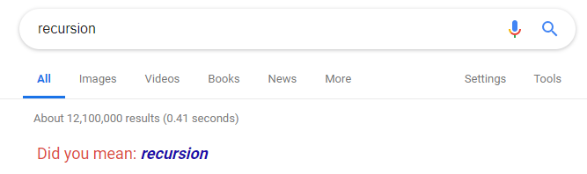
What is Recursion?
A recursive function is a function that calls itself, and returns the output
Successive executions are added to the execution stack
There must exist a base case at which the recursion stops, otherwise you will get a stack overflow
When the base case is found, values are returned down the execution stack, potentially being transformed along the way.

Slide 7
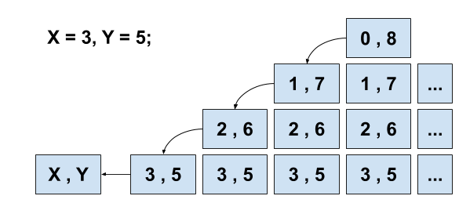
Simple Recursion – Peano Addition
public int peanoAddition(int x, int y) {
if (x == 0)
return y;
else
return peanoAddition(--x, ++y);
}

Slide 8
Recursion - Fibonacci Sequence
The Fibonacci sequence is a series of numbers that starts “0, 1, …” and every subsequent number is the sum of the prior two. (0, 1, 1, 2, 3, 5, 8, 13, 21…)
Goal: Calculate the nth index of the Fibonacci sequence.
Base case: n === 0 -> 0
Base case: n === 1 -> 1
Otherwise: fib(n-2)+fib(n-1)
function fib( n) {
if (n <= 0)
return 0; else if (n == 1)
return 1;
else
return (fib(n-2) + fib(n-1));

Slide 9
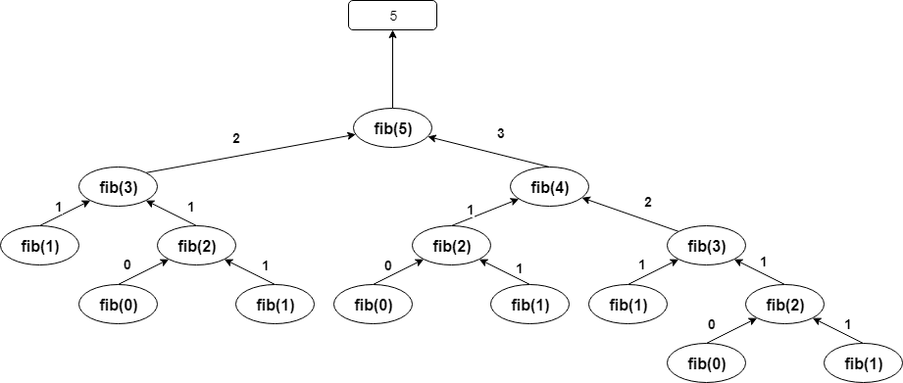
Fib(5)

Slide 10
Common Algorithms – Merge Sort
The Merge Sort is a more complex sorting algorithm that organizes elements of a collection by dividing continually dividing a collection into two halves, and then merging the split collections back together in sorted order.

Slide 11
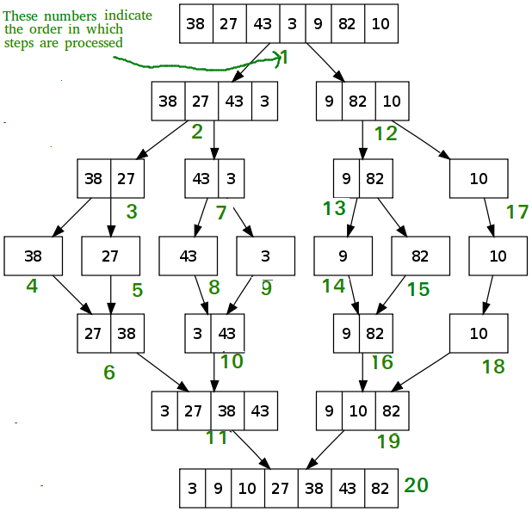
Merge Sort

Slide 12
Common Algorithms – Quick Sort
Similarly, to the Merge Sort, the Quick Sort is a more complex sorting algorithm that organizes elements of a collection by dividing elements into smaller collections.
A Quick Sort works by selecting a ‘pivot’ element and then iterating through a collection moving elements lower than the pivot value to the left, and elements higher than the pivot value to the right.

Slide 13
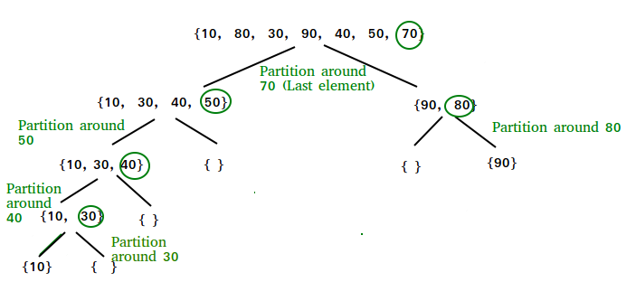
Quick Sort

